Slide 1
mino/mono DX: Director’s Cut
David Allen
Henry Wheeler-Mackta

Slide 2
The New Stuff
100 Levels
With replay value
Adaptive Difficulty
Improved Tutorial
General bug fixing and polishing
Refined sound effects
Enhanced responsiveness
Endless Mode

Slide 3
Endless Mode
Entered upon completing 70 levels
Randomly generates lines of varied (but increasing) length
One timer for all of the levels
Upon completing a level, some time is added back to the timer
Go for as long as you can

Slide 4
Frauds
Questions?

Slide 5
A Happy Ending
David Allen

Slide 6
Their Ending
Current ending is sad, frustrating, isolating
This works
A happy ending could work, contrasting the rest of the mood
Wandering, lost, until you find what you were looking for
Far more satisfying

Slide 7
My Ending
For the first time, the ending “gate” is white
Nothing else on the screen
As you approach it, it becomes a bead just like yourself
Cue the wedding march

Slide 8
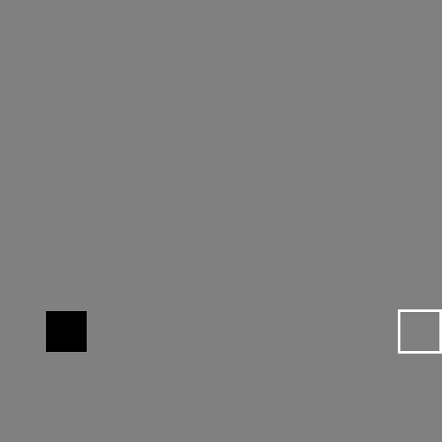


Mockups

Slide 9
S E C R E T W H I T H E R E N D I N G
Henry Wheeler-Mackta

Slide 10
The Final Level – What Was Wrong
Absolutely no sense of finality
Predictable
The game misdirects the player
Every previous level was beatable in some way, level 20 has no signifiers implying otherwise

Slide 11
The Final Level – What Was Changed
The final level is now beatable
To beat the final level, it must be failed – multiple times
This maintains the game’s foreboding and gloomy atmosphere
This provides a bookend to the first level, which also must be failed

Slide 12
Upbeat Experience Goals
Perseverance
To beat the game, the player must press on
Excitement
When the path to success is revealed, its very obvious
“Ah ha!”
The player will be excited when they beat this previously unbeatable game in a slightly meta fashion

Slide 13
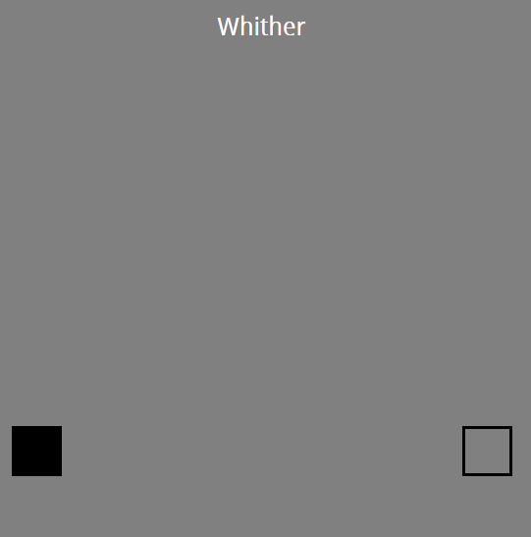
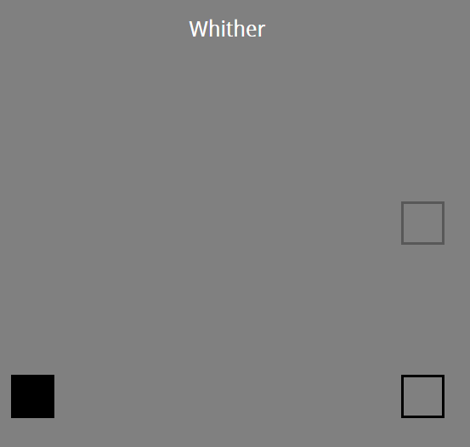
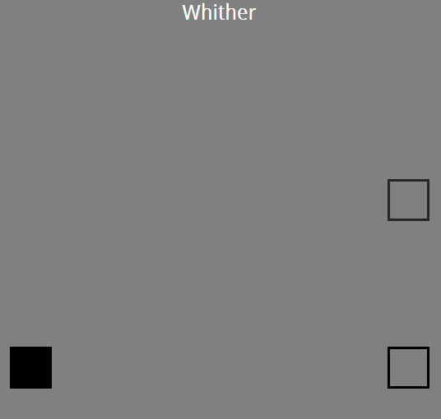
“Mockups”

Slide 14
The End
David and Henry

